Slide 1
CNNs and AEs

Slide 2

Images are a series of Pixel Values
Grayscale images:
0=Black
255 = White
Spatial locality structure

Slide 3
CNNs use three basic ideas
Local receptive fields
Shared weights
Pooling

Slide 4

Local receptive fields
Standard Neural Network (all nodes are connected, input is a vector)
Image taken from Michael Neilsen’s book “Neural Networks and Deep Learning”

Slide 5
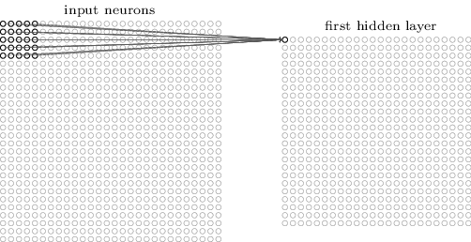
Local receptive fields
Make connections in small, localized regions of the input image
Image taken from Michael Neilsen’s book “Neural Networks and Deep Learning”

Slide 6
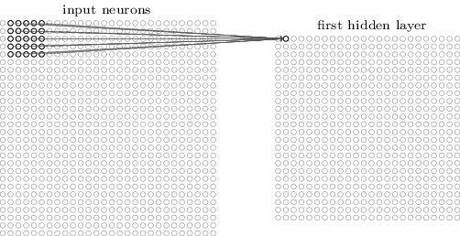
Local receptive fields
Slide the local receptive field over by one (or more) pixel and repeat
Image taken from Michael Neilsen’s book “Neural Networks and Deep Learning”

Slide 7
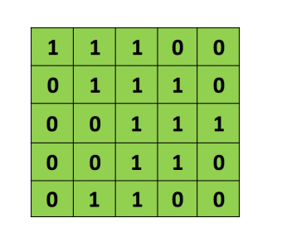
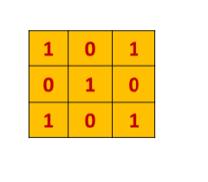

The convolution operation
Pointwise multiply
Add results
Translate filter
Filter/
Feature detector
Image

Slide 8

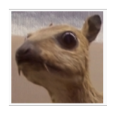
Filters
Original Image

Slide 9
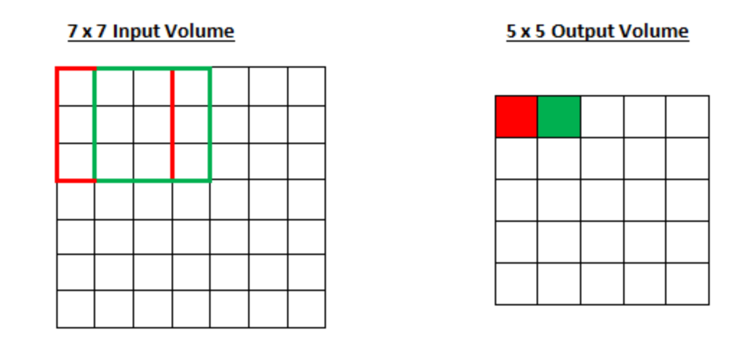
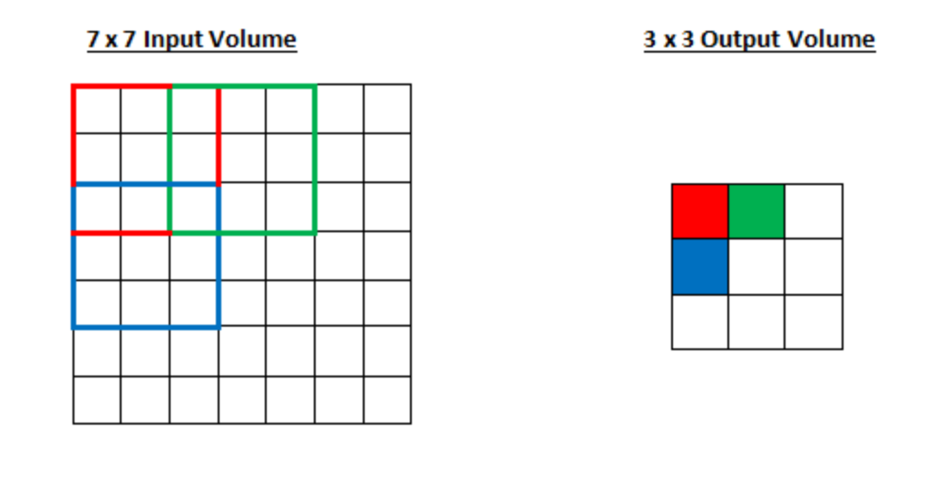
Stride
Stride 1
Stride 2

Slide 10
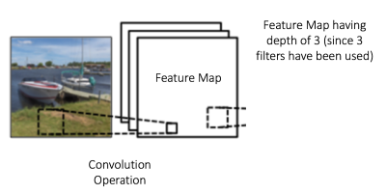
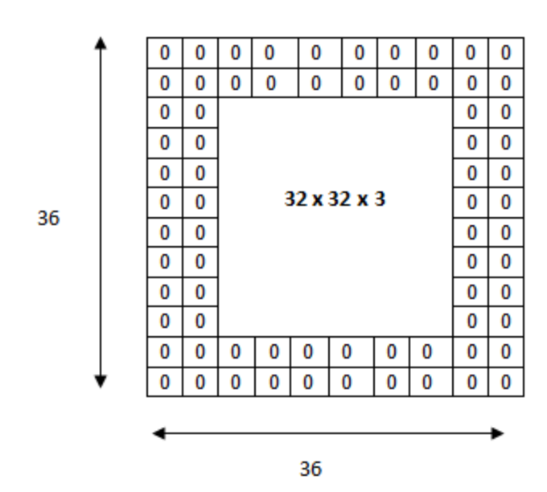
Depth and Zero Padding
Depth
Padding

Slide 11
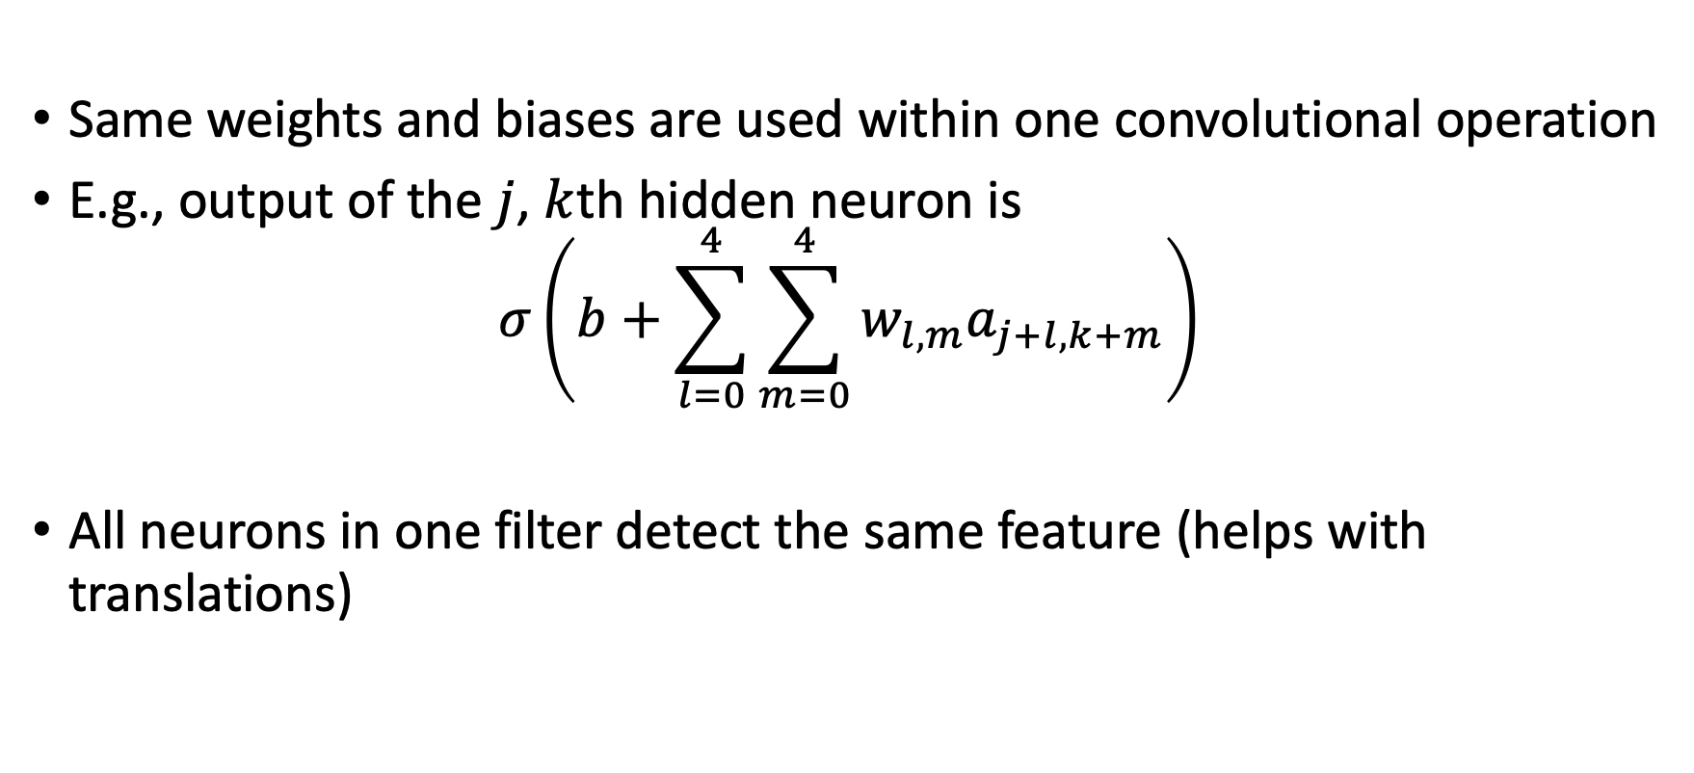
Shared weights and biases
Same weights and biases are used within one convolutional operation
E.g., output of the $j$, $k$th hidden neuron is
$$σ\left(b+\sum_{l=0}^{4}{\sum_{m=0}^{4}{w_{l,m}a_{j+l,k+m}}}\right)$$
All neurons in one filter detect the same feature (helps with translations)

Slide 12
Shared weights and biases
Why use shared weights?
Greatly reduces the number of parameters (faster training)
MNIST Example
CNN layer with 20 feature maps: 520 parameters
Fully connected neural net with 30 hidden neurons: 23,550 parameters

Slide 13
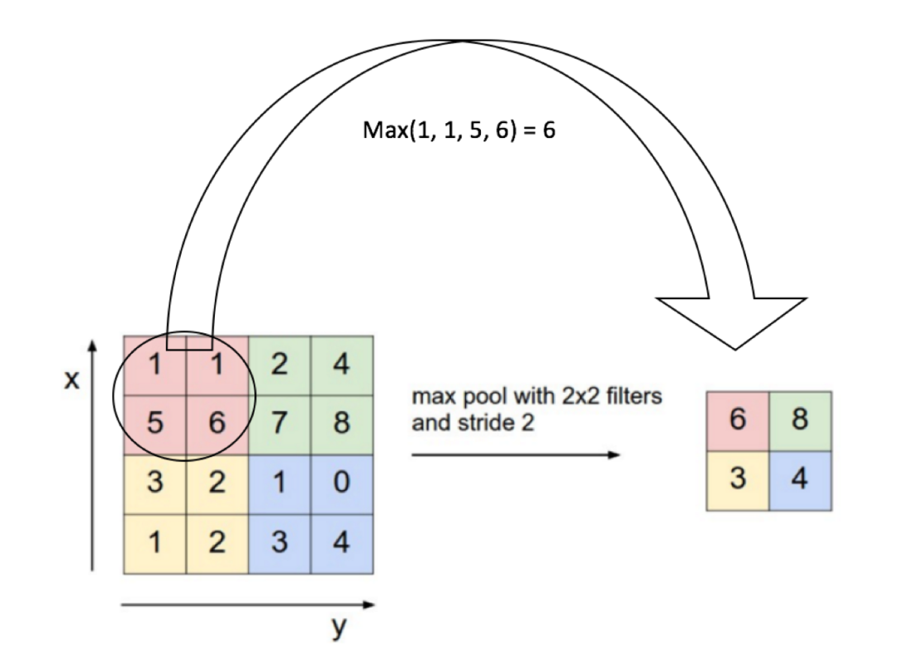
Pooling
Downsampling the results by pooling values by averaging or max
Max pool is used more commonly

Slide 14
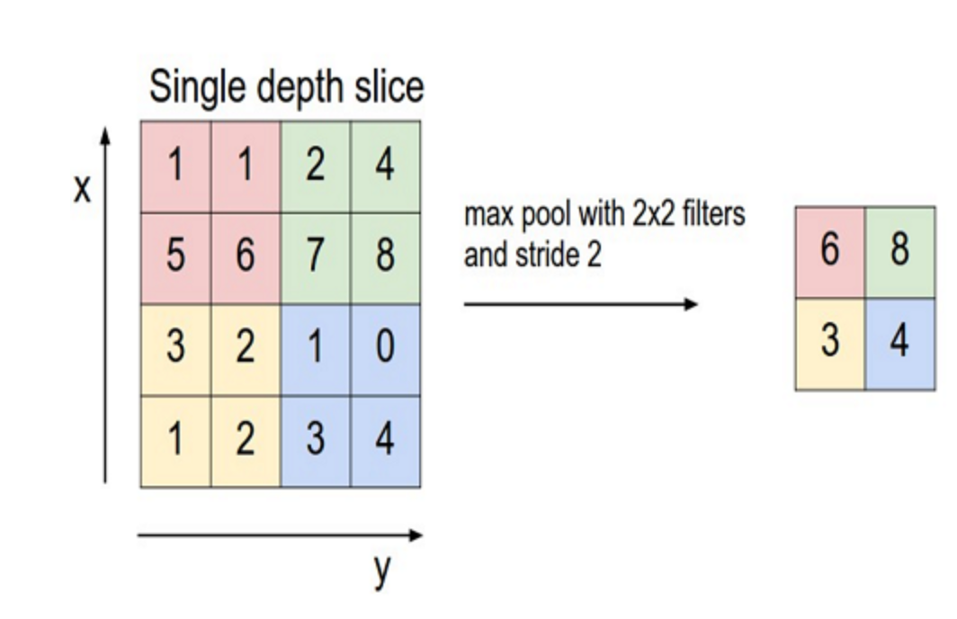

Slide 15
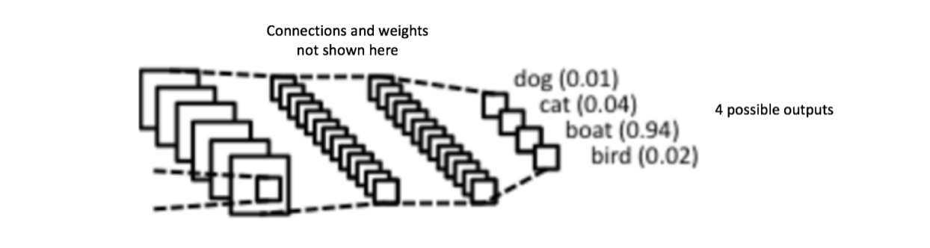
Fully connected layer to combine
Convolutional layers detected features
Pooling layers reduced complexity
Now we have a set of feature maps
Can combine them nonlinearly to classify

Slide 16

CNN Architecture
Each convolutional unit has the same weight.

Slide 17
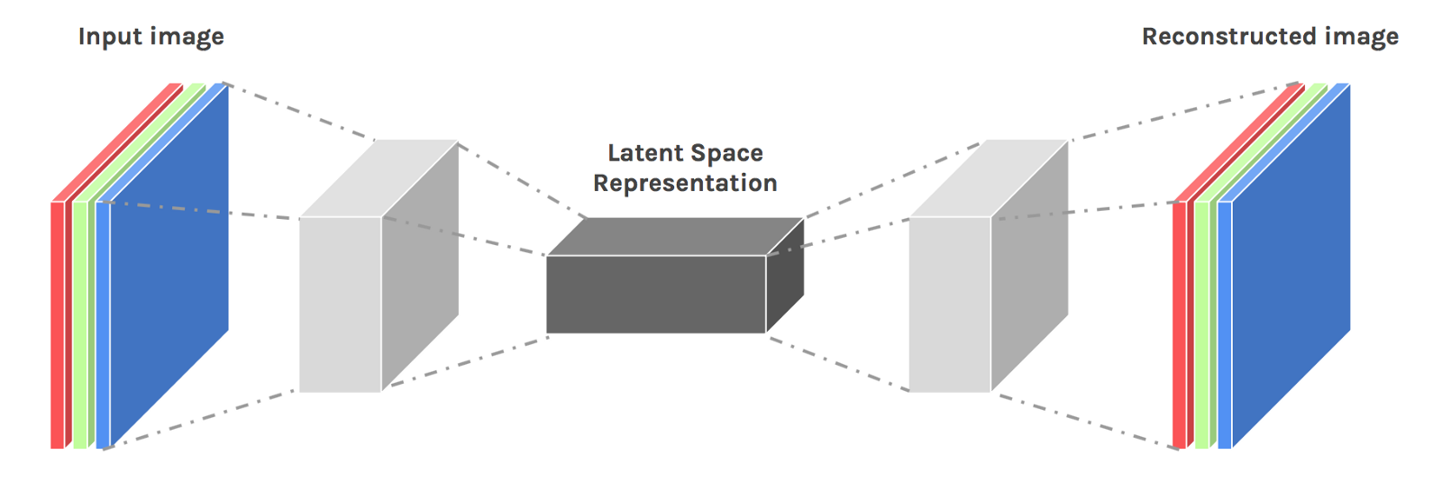
Convolutional Autoencoders
Encoder:
conv layers
pooling layers
Decoder:
transpose conv
upsampling
reduce dim
increase dim

Slide 18
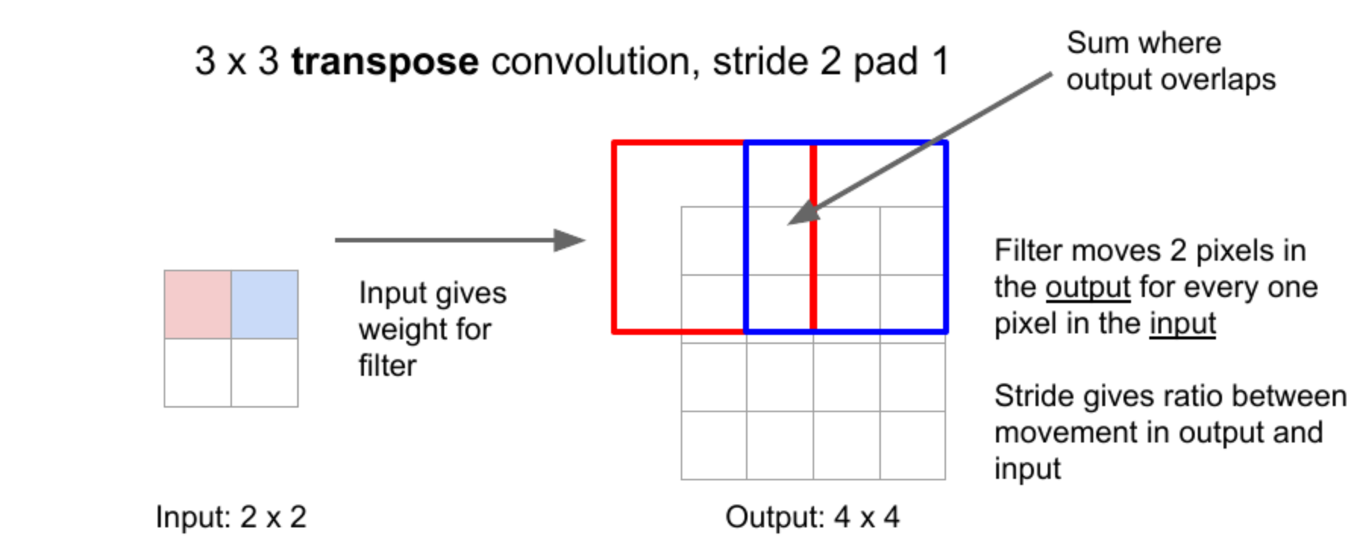
Decoding: Transposing Convolutions
Weight gives amount of input value being distributed to each of the output cells

Slide 19
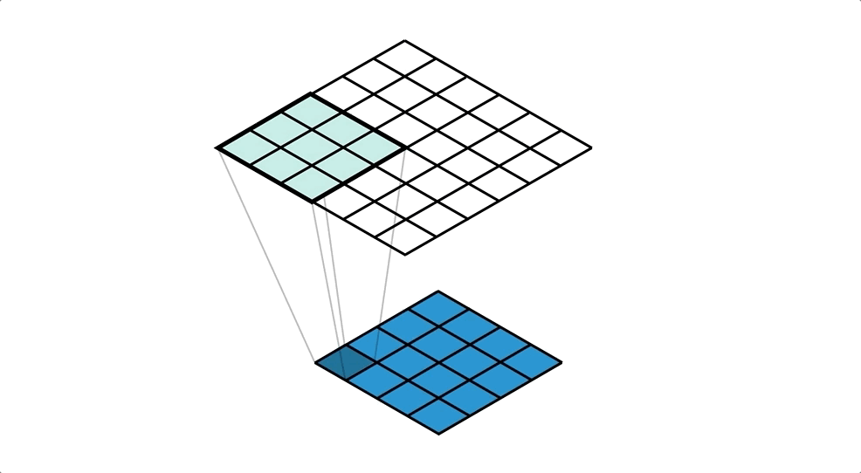
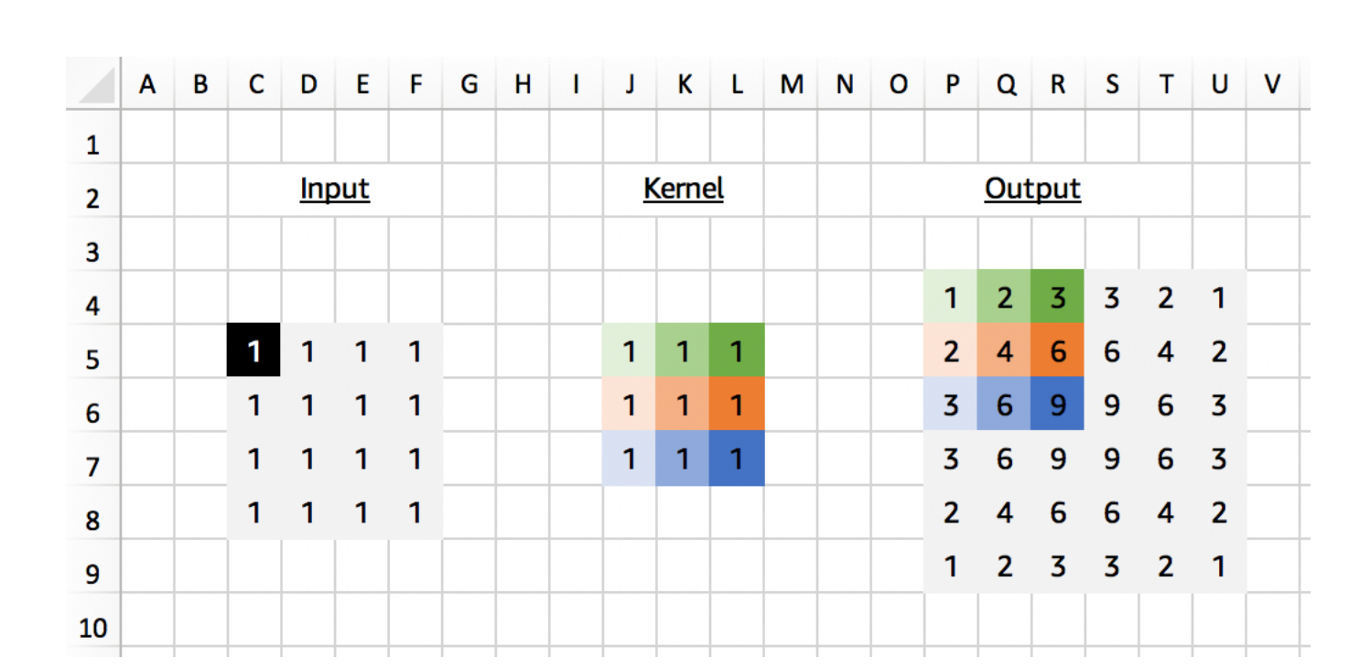
Decoding: Transposed Convolutions

Slide 20
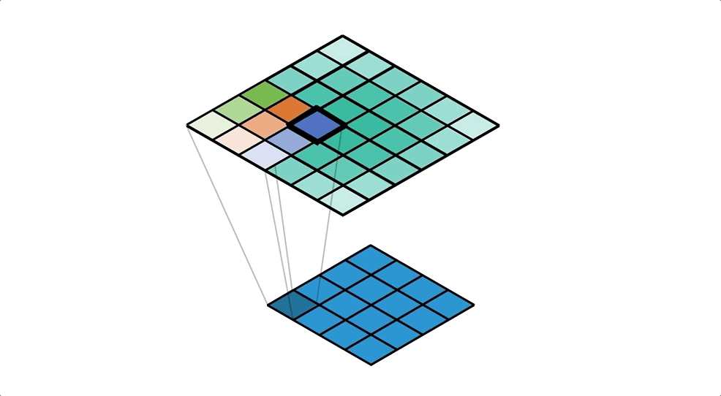
From the output cell perspective

Slide 21
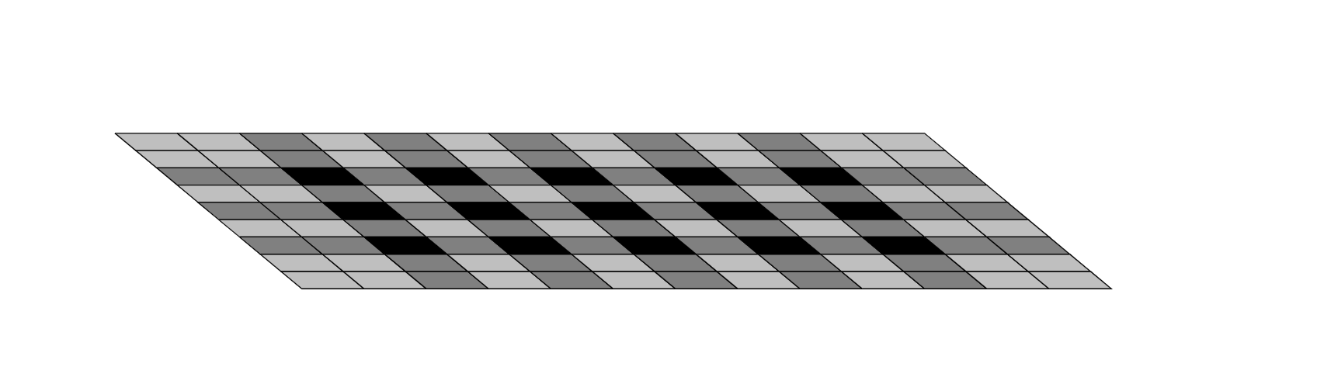
Checkerboard Artifacts

Slide 22
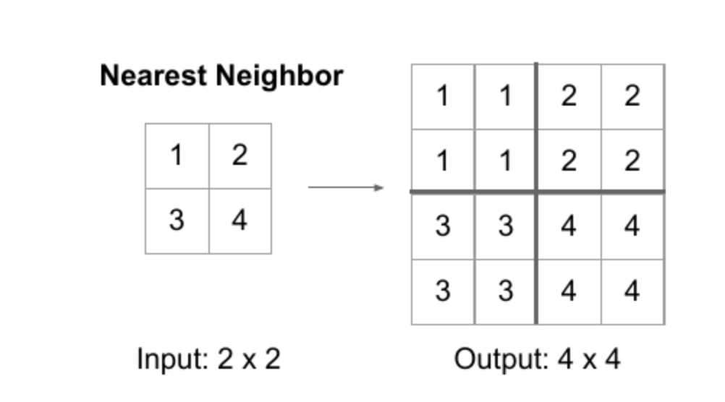
Upsampling

Slide 23
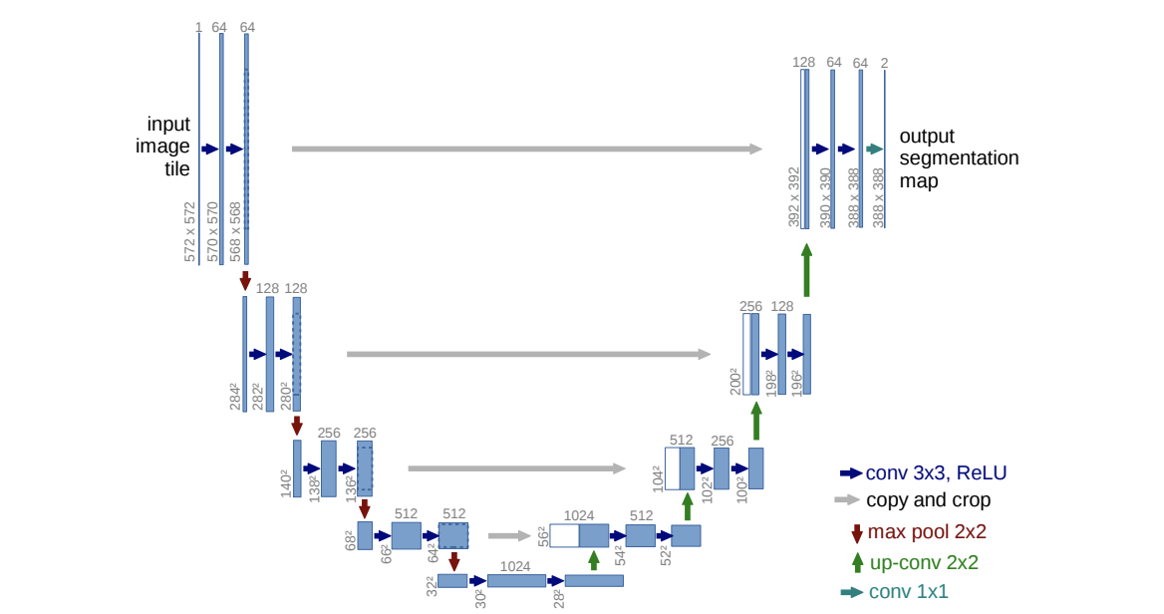
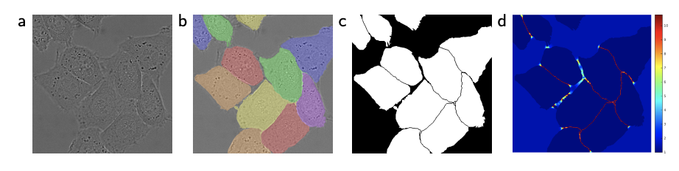
U-Net:AE-like architecture for segmentation
Ronneberger et al. 2015

